Slide 1
Similar oil well detection intelliware
Notes:
تحلیل متن با استفاده از درخت مفهومی جمله-
پردازش زبان طبیعی

Slide 2

Outline
What is the purpose?
What is similarity?
Why similarity?
Similarity detection workflow
Similarity detection Issues

Slide 3
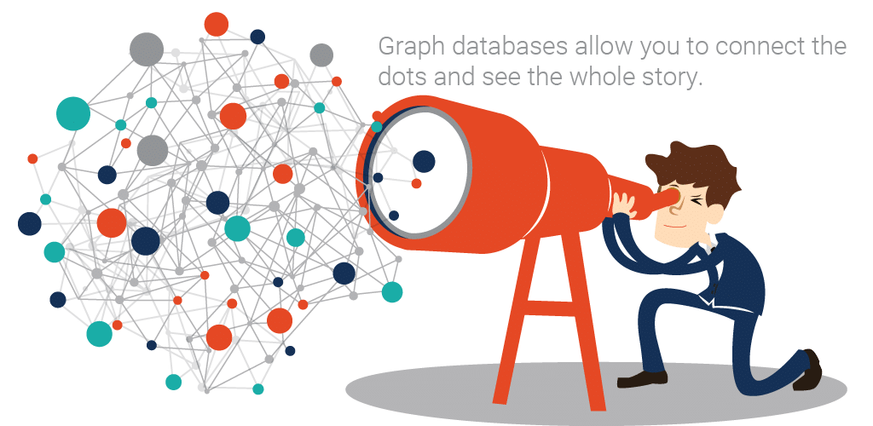
What is The Goal?

Slide 4
What is Similarity?
Numerical measure of how alike two data objects are
Is higher when objects are more alike
Often falls in the range [0,1]

Slide 5
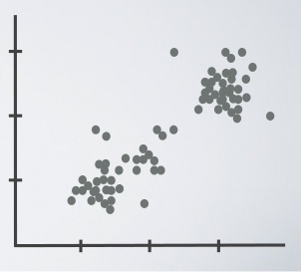


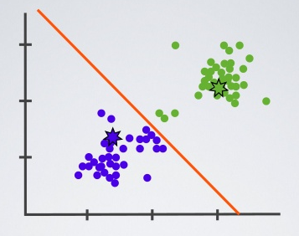
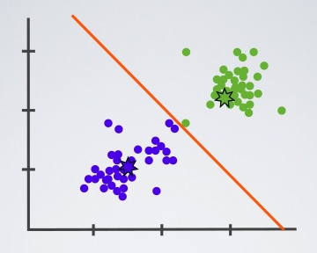

Slide 6
